Slide 1
Lead generation Case Study
Umashankar

Slide 2
Dataset
The data set contains of around 9000 records of leads that needs to be analyzed,
Few Numerical Columns
Lead Number
Total Visits
Total Time spent on Visits
Page Views Per Visits
Asymmetric Activity and Profile Score
Other columns were categorical in nature
Total of 37 columns

Slide 3
Data Processing
There were few columns which had more the 50% null values
Some columns has values such as ‘Select’ which is again same as Null values indicating the user has not selected any options in the dropdown forms
So considering those values we could drop few columns that were having more that 50% null
And other columns had mode than 30% null values
Assumption : out of that columns which has arounc 30% null values I assumed that ‘Tags’ and ‘Specialization’ Might have impact on the results so Introduced a dummy category for null values and dropped all other columns

Slide 4
Model Building
As a process of Model Building all the categorical columns had to be encoded, and after encoding we had around 109 columns
Used Minmax-scaler for Scaling the data
At this point There were few columns with high collinearity
['Lead Source_Facebook', 'Last Notable Activity_Email Marked Spam', 'Last Notable Activity_Resubscribed to emails']
Which we dropped
Since the Independent variables are very high in number I used RFE to select 15 variables that affects the Model
Then we arrived at the optimal Model

Slide 5
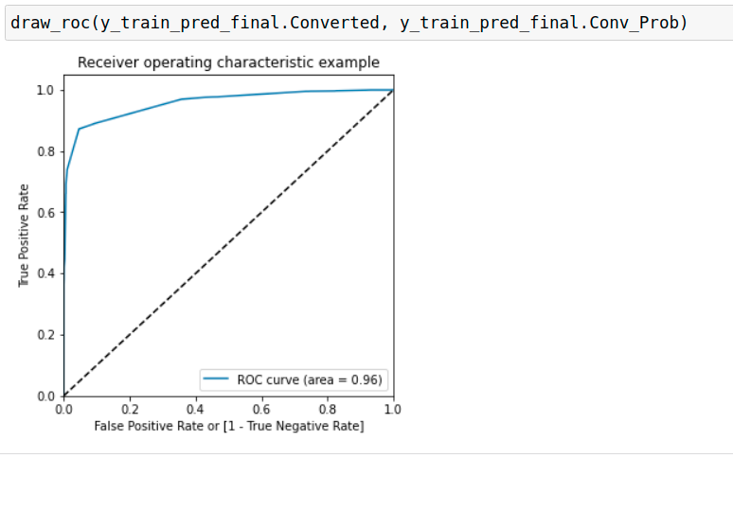
Evaluation
Used ROC Curve to identify if the model is reliable
Initial Metrics Metrics: (cuttoff 0.5)
Accuracy : 0.93
Sensitivity: 0.87
Specificity: 0.95

Slide 6
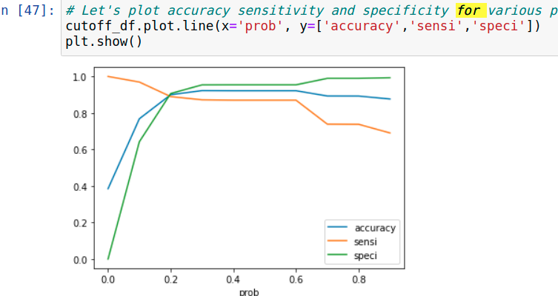
Evaluation
After plotting the accuracy, specificity and Sensitivity for cutoff rangin 0.1 to 0.9 we find that 0.2 is very optimal for the model which still gives 0.9 accuracy

Slide 7
Business Conclusions
Most Positively Influencing variables:
Tags_Closed by Horizzon
Tags_Lost to EINS
Tags_Will revert after reading the email
Variables with negative Coefficient
Tags_switched off
Tags_Ringing
Tags_Diploma holder (Not Eligible)
Business should concentrate on these Variables in-order to generate higher Conversion Rate

